Slide 1
Watersheds with possible point source concerns
Oct 2015

Slide 2
1MGD = 1000000 gallons/day
= 3785.411784 m³/day
= 0.04381263639 m³/sec

Slide 3
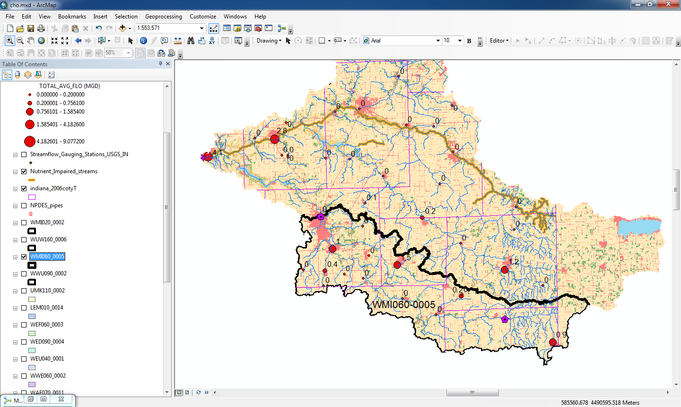
WMI 060-0005
14 WWTP yield 4.5 MGD in this watershed
0.197 m³/sec (Avg.): 2.2%
Baseflow: Avg. 9.1 m³/sec, Min. 0.84 m³/sec

Slide 4
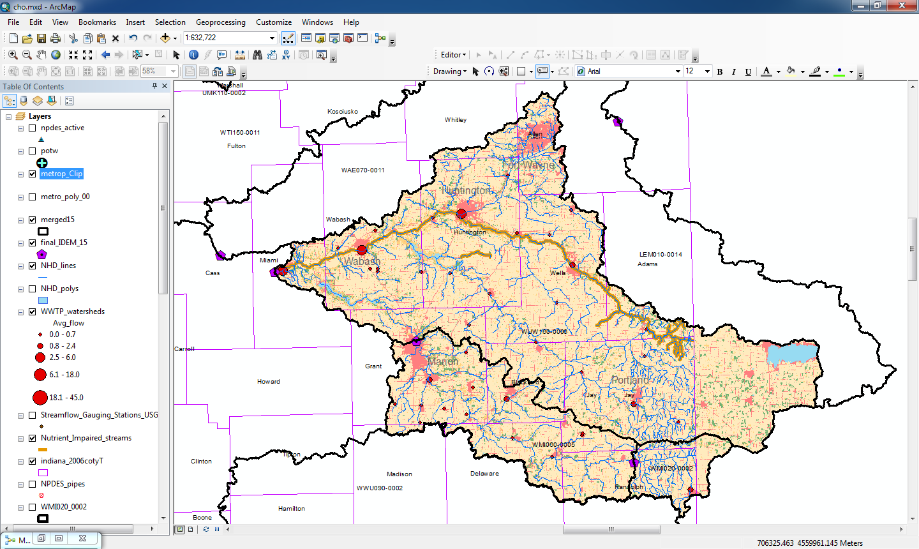
WUW160-0006
40 WWTP yield 22.6 MGD in this watershed
0.990 m³/sec (Avg.): 2.6%
Baseflow: Avg. 38.0 m³/sec, Min. 3.62 m³/sec
Nutrient impaired river

Slide 5
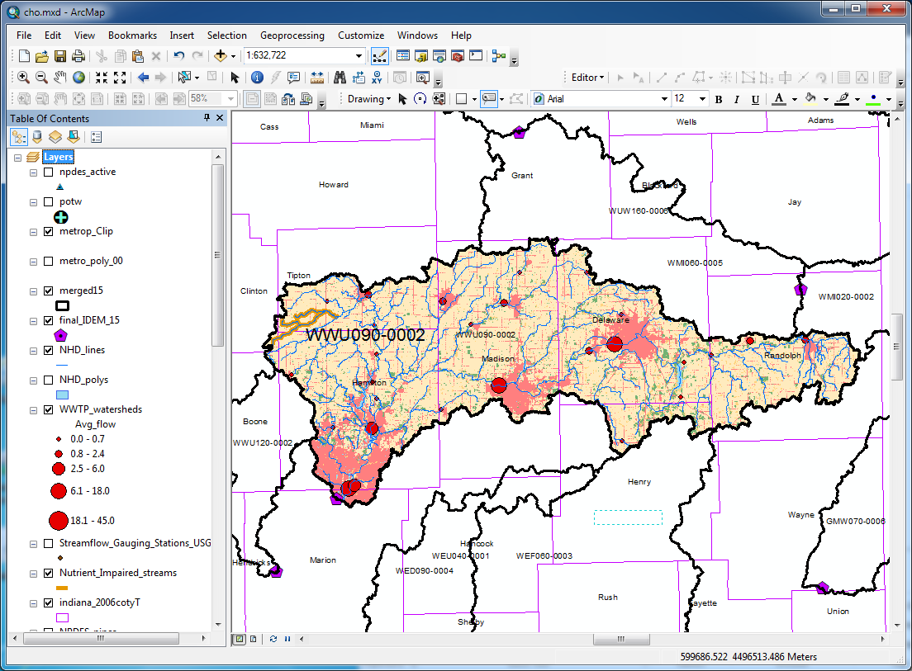
WWU 090-0002
27 WWTP yield 64 MGD in this watershed
2.804 m³/sec (Avg.): 12.1%
Baseflow: Avg. 23.2 m³/sec, Min. 3.53 m³/sec

Slide 6
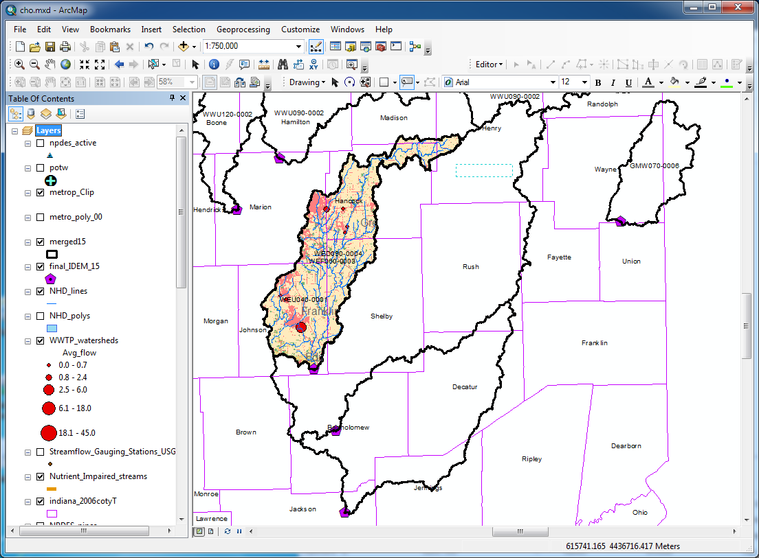
WED 090-0004
7 WWTP yield 6 MGD in this watershed
0.263 m³/sec (Avg.): 3.1%
Baseflow: Avg. 8.50 m³/sec, Min. 0.62 m³/sec

Slide 7
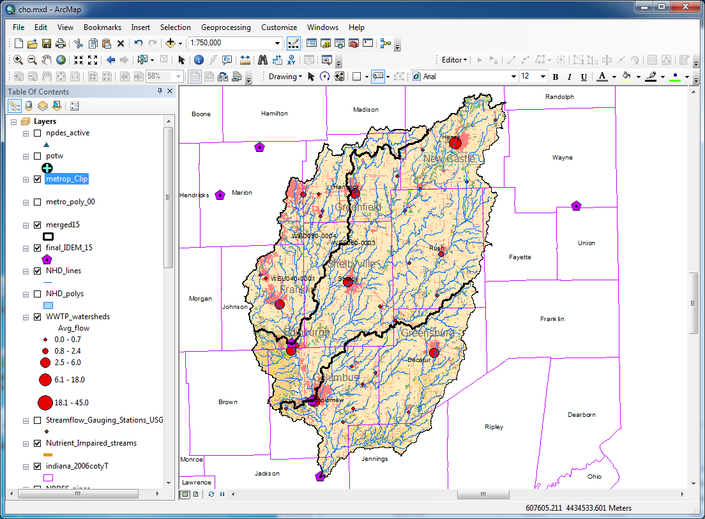
WEU 040-0001
35 WWTP yield 43 MGD in this watershed
1.884 m³/sec (Avg.): 3.4%
Baseflow: Avg. 55.4 m³/sec, Min. 6.09 m³/sec

Slide 8
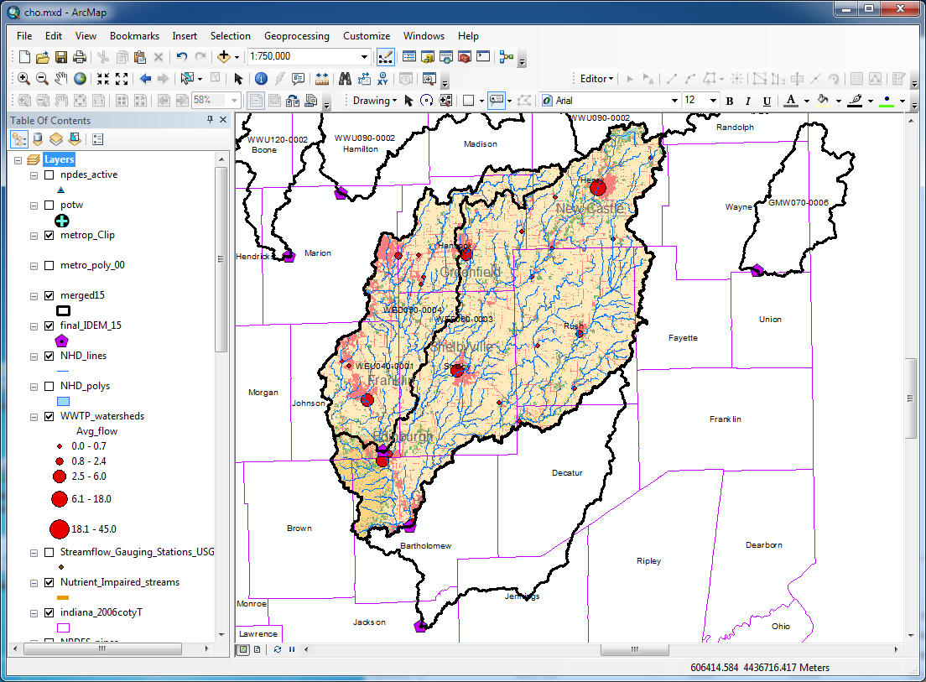
WEF 060-0003
26 WWTP yield 30.2 MGD in this watershed
1.323 m³/sec (Avg.): 3.6%
Baseflow: Avg. 36.8 m³/sec, Min. 2.56 m³/sec

